Slide 1
Genesis 25:27-34
The Most Expensive Meal
Designed and Preached by Student Ho Yin Yin Uploaded by Dr. Rick Griffith • Singapore Bible College All files in many languages for free download at BibleStudyDownloads.org

Slide 2
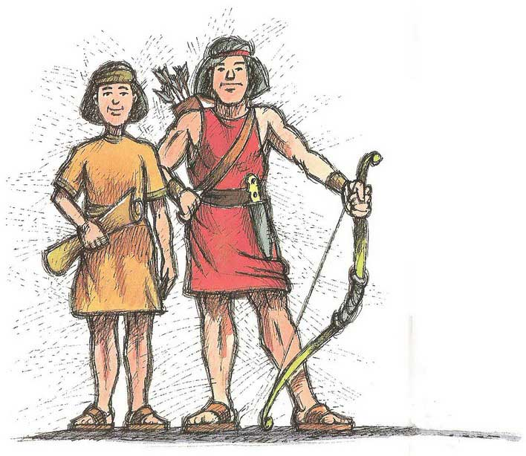
Introducing…. Esau & Jacob
Gen 25:27-34

Slide 3
Characteristics of An Ungodly Man

Slide 4
I. An Ungodly Man Pleases Himself (Genesis 25:27-28)

Slide 5
II. An Ungodly Man forsakes Valuable Things to satisfy Personal Appetites (Genesis 25:29-33)

Slide 6
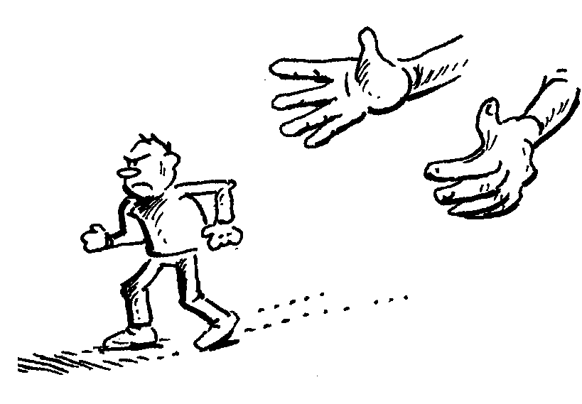
III. An Ungodly Man turns away from Godly Things (Genesis 25:34)

Slide 7
Main Idea: Do not give up your spiritual blessings for worldly pleasures

Slide 8
Black

Slide 9
OT Preaching link at BibleStudyDownloads.org
Get this presentation and script for free!
Notes:
OT Preaching (op)

